Slide 1
ORRVILLE UTILITIES 2022 Annual Report Jeff Brediger, Director of Utilities
Notes:
Presentation to Utility Board 4/10/23.
Presentation to City Council 4/3/23.
Appointed Director in August 2009. I have been with Orrville Utilities for 36 years and in the utility sector for over 41 years.
There are additional detailed and reference slides at the end of the report.

Slide 2
Public Utility Board
Board Members -Michele Abel (Pro 31 Tax Services), President -Steve Combs (Retired), Vice President
-Russell Miller (JM Smucker Co.) -Joe Messenger (Ohio St. University) -Rich Corfman (Retired)
Meetings held every 2nd & 4th Monday at 6:30PM
Notes:
ok- Background.
The Public Utility Board, by City Charter, is responsible for operation & maintenance, improvement or expansion and the establishment of rates for the Electric, Water & Wastewater Utilities. Board members are appointed by the Mayor and serve staggered, 5-year terms.
The Board appoints the Director of Utilities who manages the Electric, Water & Wastewater Utilities. The Board provides independent oversight & control which separates politics from the picture. There are just a few communities governed this way in Ohio.
All utilities are non-profit and have their own enterprise funds (i.e. rates are set separately to ensure each Utility is independent & financially sound). This financial separation also keeps politics at arms length to allow the utility to operate more like a business that is still controlled locally.
There is no formal subsidizing between the Utilities or City. By ordinance, however, the City receives free electric for the buildings & street lighting as long as it remains economically feasible.
In addition, the Utility operates 65 miles of fiber optic communication systems & provides City-wide computer systems and network support.
All Utilities are relicensed (operating permits renewed) 5 years. Generally the EPA imposes additional limits & operating restrictions with each renewal.

Slide 3
Highlights
Total Utility expenditures, $45.6M- Electric $38.4, Water $4, Wastewater $3.2. 2023 Budget $57.5M.
Stabilized electric rates again for the entire year
Ordered 3 transformers for second transmission line interconnection project, $6.1M
Added 2MW of energy coming from Fremont Project bringing total to 26MW.
Began study to determine excess infiltration of water coming into the Wastewater facility
Notes:
ok- Total revenues were similar to 2021. 2023 budget includes several significant capital projects in all utilities (details shown later in this presentation). Electric rates stabilized for the year again despite some significant challenges. Same rates since mid 2016.

Slide 4
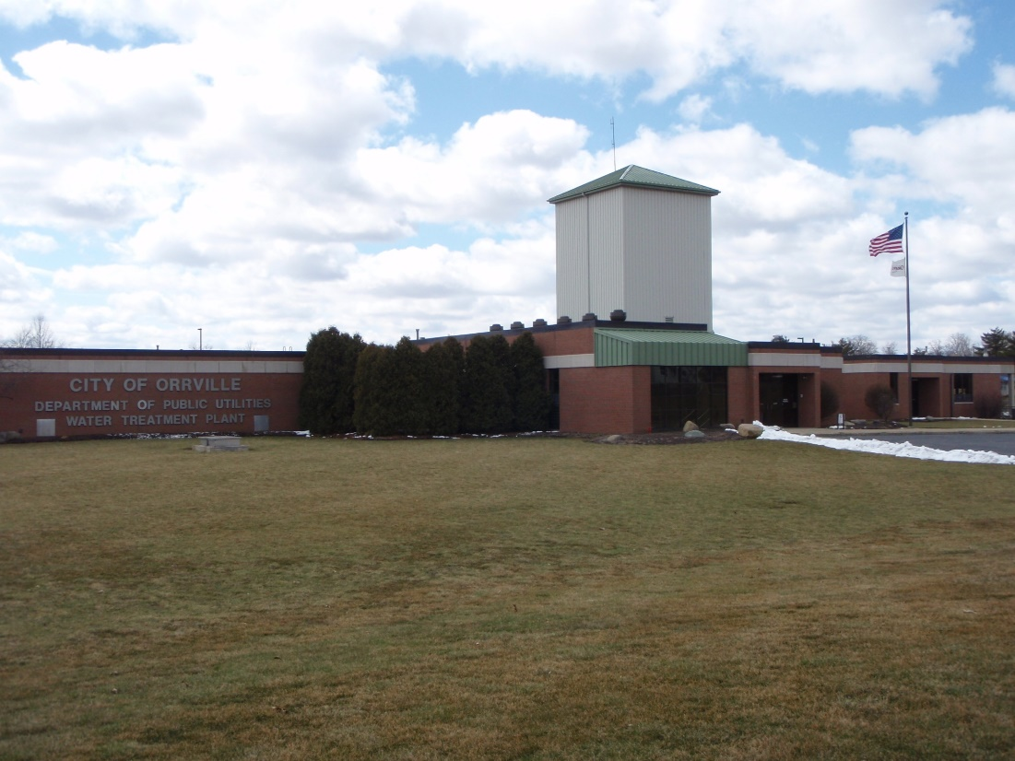
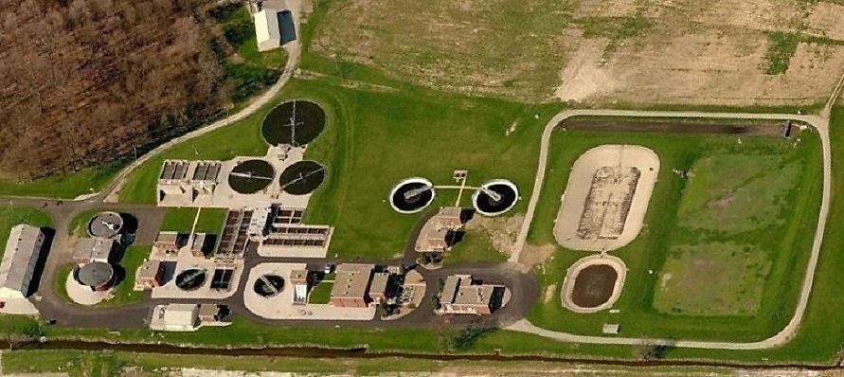
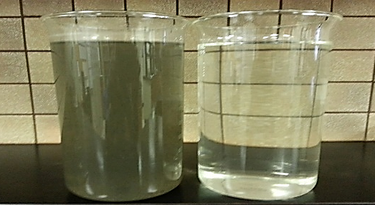
Water facility
Wastewater facility
Notes:
ok- Use for City & Utility presentations.
Water Utility, Established 1894. Plant built in 1997.
Raw water from 11 underground wells from four separate well fields is pumped to the Water Plant then proceeds to lime softening, stabilization, re-carbonation, filtration, fluoridation and chlorination processes before coming to your faucet via 61 miles of lines, provided 1.5M gallons/day (560M gallons/yr) to 3700 customers annually.
Fluoridation started in 1958. Once started, we can not stop per EPA regulations. Renewed EPA NPDES permit in 2022 (renewal in 2027).
Wastewater Utility, Established 1908 . Plant built in 1951, expanded in 1969 & 1989.
This facility handles the most complex and dynamic processes of all three utilities.
We also manage six industrial pretreatment programs where Orrville must (required by law) enforce federal, state and local industry specific discharge limits and rules for the EPA.
42 miles of lines, 3 lift stations, treated 2.2M gallons/day (800M gallons/yr) & land applied 1.4M gallons bio-solids which is a typical amount for a community of 35,000 (Orrville 8,437 based on 2023 census estimate. Renewed EPA NPDES permit in 2020 (renewal in 2025).
Projects- Reducing inflow & infiltration, smoke testing, new aeration tank diffuser, new aeration system blowers, raw influent pump & motor control center replacement.

Slide 5
Notes:
ok- Combined Water & Wastewater information. Revenues are just from customers, not total revenues. I refer you to Ms. Strimlan’s upcoming April 17, 2023 report for more detail.
Water revenues were up (7.6%), usage up (2.5%). Interdepartment is mainly the power plant which used to be 25-30%.
Wastewater revenues up 5.4%, usage down 1.6%.
Water debt service was paid off in 2022. Only a zero interest load remains.
Wastewater has been debt free since 2014.

Slide 6
Notes:
Ok
Typical year to year.

Slide 7
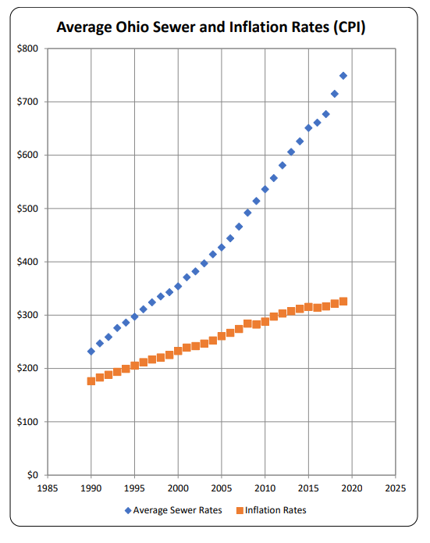
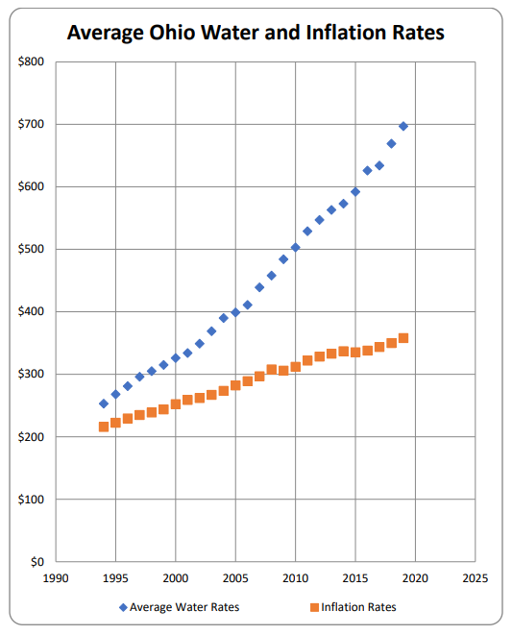
State $780
Orrville $702
State $671
Orrville $592
Notes:
ok-
Our rates shown are for 2022. The State has not updated the report for the last two years.
Most of our customers bills are lower due to lower usage.
As a reminder, water rates increased dramatically in 2017 after the EPA imposed operating restrictions on the power plant which, at one time,
accounted for over 30% of the water utility’s revenues.
Source: OEPA 2020 Water & Wastewater report.

Slide 8
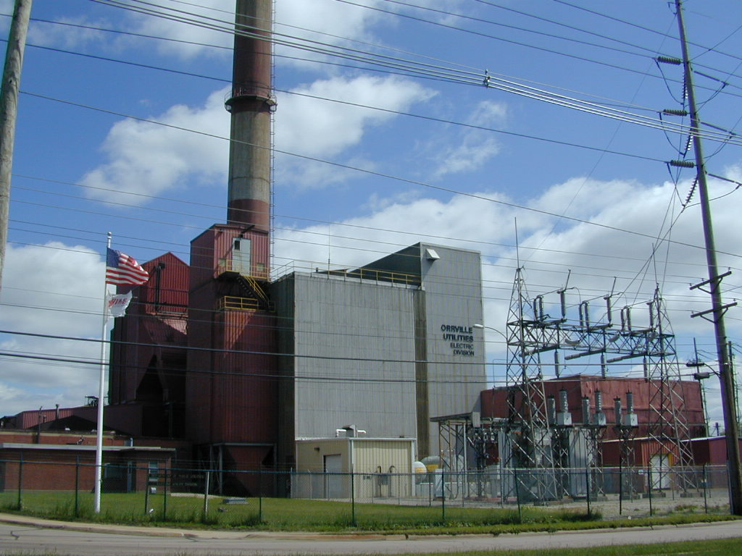
Notes:
Ok- Electric Utility. Established 1917. Four coal & gas-fired steam generators, three turbine-generators with total capacity of 63MW. Last unit installed in 1969, 7400 customers. Approx. 300 pole miles distribution covering over 125 sq. miles.
Orrville is only 1 of 3 communities (Dover, Painesville is peaking only) in Ohio that generate their own electricity (at one time there were around 90). Others shut down due to age, lower rates offered by investor-owned utilities,, cost & regulations.
We also own our distribution system (poles & wires) and 8 mile transmission line to an AEP substation were we’re connected to the national electric grid.
Power Plant net generating capacity ~58MW. Three steam-turbine generator units (one 22MW and two 25MW). Unit 9 (22MW) installed in1963, Units 10 & 11 (25MW each) installed in 1969 (these are the original units from Dept. of Defense’s Oak Ridge, TN plant which was part of the Manhattan Project, the atomic bomb development program, originally installed in 1941. Added 3 diesel generators, 5.5MW, in 2021 (purchased from AMP) to assist in peaking & emergency needs. Located at the Wastewater Treatment plant.
The oldest boiler (steam generator) was installed in 1951 (Boiler10), 1957 (Boiler 11), 1963 (Boiler 12), 1969 (Boiler 13).
Debt free since 2010.

Slide 9
92% less since 2010
Notes:
ok- Power Plant’s carbon footprint has reduced significantly over the past 10 years. Started decline in 2016 to convert largest unit
to natural gas following EPA notification in 2015.
C02 emissions are the primary contributor linked climate change.
In 2010, the Power Plant was supplying most of the energy. It supplied >5% in 2022.
Our largest unit was converted to gas in the fall of 2016. New EPA restrictions effective January 2017.
Source: 2022 GHG report

Slide 10
Typical prior
To 2013
Notes:
ok- Charts show the percent of energy from sources to serve our customers. In 2015, all of our projects, except solar was in in operation. Power Plant is Blue (~50/50 coal & gas).
The decline in output from the power plant is attributable the EPA mandated operational restrictions which went into effect January 31, 2017.
Orrville generation percentage typical since 2018.
Hydro projects production increased this year.
The next series of charts get into the details & complexities of power supply options.
Source: Generation Portfolio report in Power & Energy Reports file.

Slide 11
JM Smucker Co.
Quality
Castings Co.
Notes:
Ok- Typical breakouts.
Approximately 20% of our customer sales are located outside City limits. Approx. 88% of our 7200 customers are residential.
About half our sales come from 20 customers and over half of these sales comes from 2 customers!
From Industrial Customer Usage & Retail Sales History reports.

Slide 12
Notes:
ok- A more detailed look at our top industrial customers by electrical usage, in kWh’s. We sell about 300,000,000kWh’s annually.
From Industrial Customer Usage report.

Slide 13
Notes:
ok- Rapidly increasing transmission costs are still a concern. It was one of the top issues discussed with our legislators in Washington earlier this year.
Our ability to operate during the peak periods enables us to receive financial credits to off-set a large portion of the fees we pay. In addition, we generally sell into the wholesale market during these times which allow us to generate additional revenues.

Slide 14
Notes:
ok- Updated 2/23/23.
Some history. AEP is the transmission owner. PJM is the transmission or grid operator (in multiple states) in our region. We pay fees to both.
Number in (red) shows the cost our customers have to pick up (direct pass-thru). The green shows the credits generated by the Power Plant (no fuel or O&M costs).
Transmission owners receive fees i.e. full cost recovery plus 9-12% ROE on upgrades and expansion of the grid whether it’s needed or not. There is little oversight by the government to confirm the need for the projects the utilities are spending money on.
Transmission credits are generated by the Power Plant & diesels or other load reduction measures during the top 5 peak demands (5CP’s) during the year. Most communities issue alerts and ask customers to make changes (lower thermostats, energy efficiency projects, tiered or seasonal rates, reduction of production).
Everyone can help in this effort. The more we reduce, the more everyone saves.
Generator 9 estimated transmission credit is $1.8M, Generator 10 $3.3M, Generator 11 $3.6M, diesels $0.6M.
The larger difference in 2017 was due to Generator 9’s outage (outage occurred in 2016 but financial impact not realized until following year).
Source: 2023 Sales & Purchases report, AEP & PJM details tab

Slide 15
ACV, Gradall, Orr Products,
Morton Int'l plant closings-2002
Notes:
ok- Retail sales are closely tied to industrial usage. Industries account for ~50% of all energy sold.
Grey periods indicate recession periods. Note declines in sales leading up to & during most of the time period.
Major investments in the plant were made in 1986-87 based on our growth rate including participation in our first AMP generation project in 1988 (Gorsuch project).
Early 2002-2011 was a tough period due to plant closings and further focused our efforts in economic development (Orrville Office of Industrial Development created in 1996)- ACV, Gradall, Orr Products & Morton Int’l closed in 2002. Ross Sandcasting & Orrville Bronze closed 2011.
From Retail Sales History 1964-YTD report.

Slide 16
Notes:
We have mostly recovered from COVID period.

Slide 17
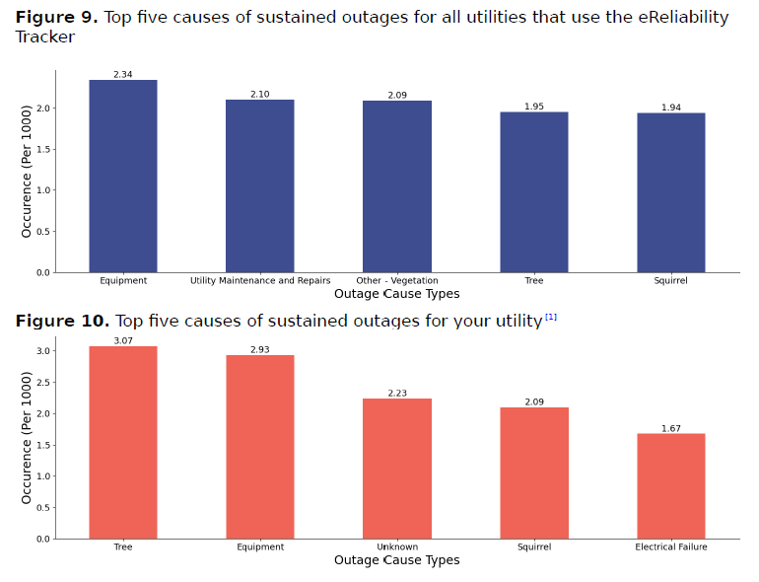
Notes:
We had an unusual number of severe storms this past year that increased our customer outage time.
We did not have to use AMP or APPA’s mutual aid program. We did send crews to assist other AMP members.
We are generally back home before AEP and FE restore service.
Source: 2022 APPA Annual Benchmark report

Slide 18
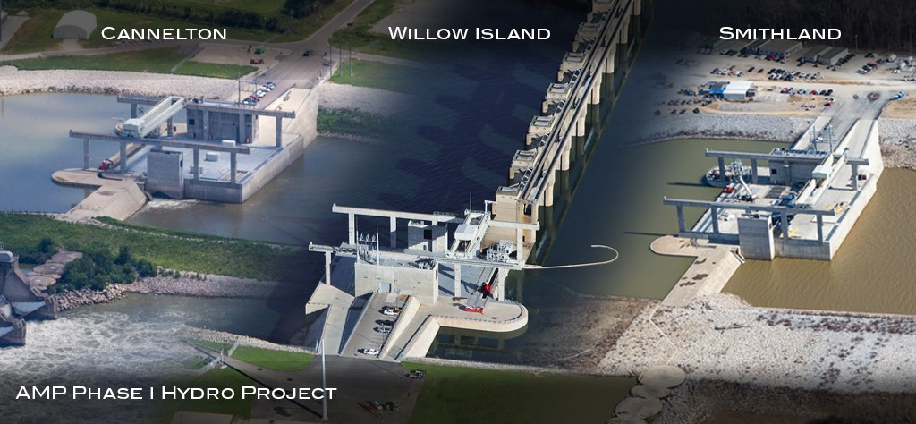
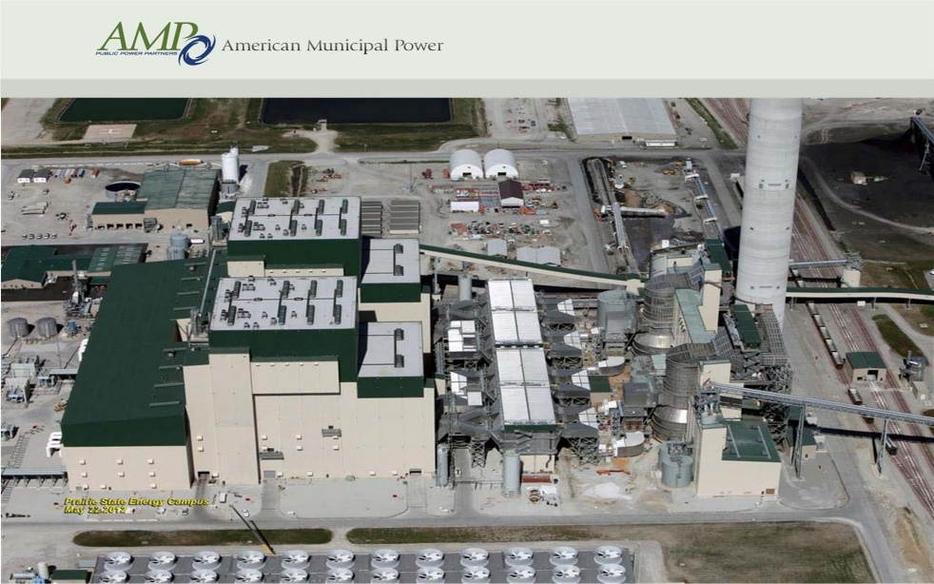
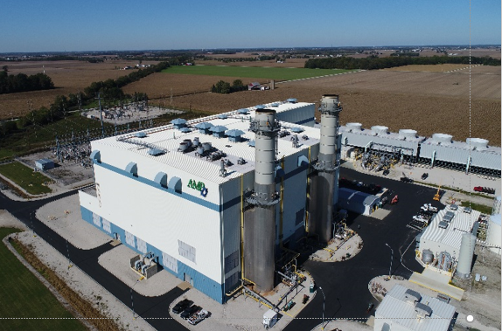
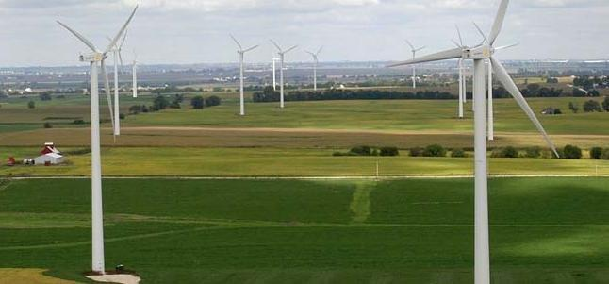
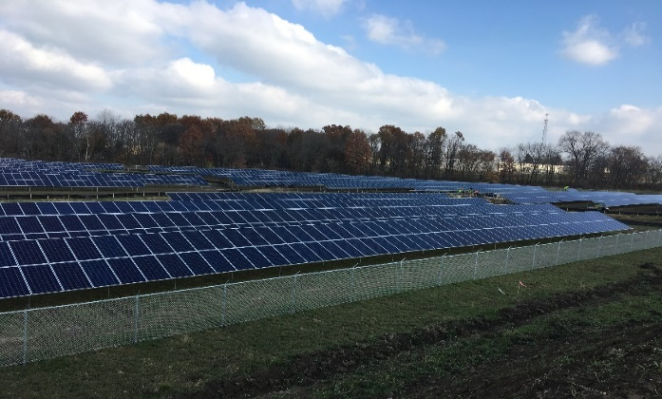
Notes:
Ok- High-level project slide. Details in reference portion of slide deck.
These projects & market purchases allow us to diversify to lower our risk exposure due to environmental & regulatory uncertainty, energy market & fuel volatility as well as positioning ourselves for future challenges at the power plant.
Hydro’s- 4 sites along Ohio River (3 shown in pic), 350MW, $3.5B. We have 11.6MW coming from these units.
Prairie St- 2 units in Illinois, 1600MW, $4B. We have 5MW coming from this project.
Fremont- 2 units in Fremont, OH, 700MW, $675M (purchased at deep discount, partially constructed from FirstEnergy). We have 26MW coming from this project.
Wind- Purchase 2MW from 150MW site from private developer in Ohio located off SR30 near Indiana border. Program ended July 2022.
Solar- 2 sites, 1 & 2MW, in Orrville. Part of a 60MW, 16 communities in four states, $88M project.

Slide 19
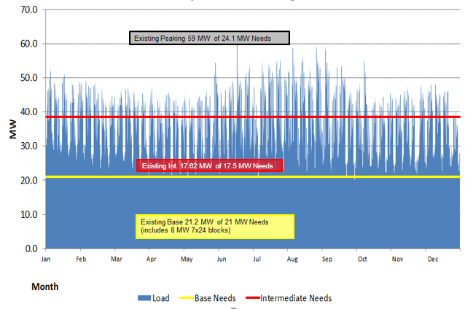
2022 Hourly Load & Long Term Resources
High to Extreme Cost
Moderate Cost
Lowest Cost
Notes:
ok- Base: power is needed all the time, 24/7. Some plants (like nuclear & coal) are designed to operate in this mode and purchasers of energy for this need generally pay the least.
Intermediate: additional power needed during higher usages times (M-F and summer & winter periods)
Peaking: maximum usage (extreme temperatures & emergencies)
Power Plant is now a peaking resource (Base source prior to 2017).
We met our base load needs with the purchase of the two 4MW blocks of energy combined with AMP projects.
We continue to evaluate needs and strategies for the long term.
We use the following charts to meet these ever changing needs to keep cost low and reliability high.
Source: AMP

Slide 20
Notes:
ok- MWh’s shown below 0 (yellow bar) represent sales that were made into the wholesale market.
Each energy source has a separate price and is available during certain times. For example, solar & wind only available 21% & 18% of the time last year vs,
Prairie St 95% and market 100%. Each are subject to variable fuel cost, transmission capability, equipment availability. The next two slides give you an
idea of the many components that go into bringing energy to our customers.
Source: 2022 Sales, purchases report

Slide 21
Notes:
ok- Shows how much energy comes from each source and associated cost.
We purchased the AMP diesels on 12/31/20.
Total market purchases are the combination of CITI Group & Market Purchases, representing 21% in 2022 .
The CITI purchases are fixed, multi-year purchases.
Market purchase are a combination of real time and day ahead purchases.
We use this chart and the following chart to make decisions when purchasing energy and evaluating future projects.
Source: 2022 Sales, purchases report

Slide 22
Notes:
ok- Shows percent of time energy source can delivery energy and the amount of energy we receive form each source.
It would be nice to receive more energy from NYPA hydro but our allocation is limited. It is the cheapest energy we receive.
Market purchases are the next lowest cost energy source, we purchase the balance of our needs here after we take the contracted output from the AMP projects.
Solar & wind were only available 21% and 18% of the time last year. The next chart shows their output during the year.
Energy generated from the power plant is generally not scheduled and is sold into the wholesale market when we are operating for peak needs.
Source: Sales, purchases report

Slide 23
Notes:
ok- Capacity is a measure of how long the unit was generating. 100% represents, operating 24hrs/day, 7 days/week, 365 days /yr.
Base load units are designed and typical operate 90% of time- Coal, nuclear, oil, natural gas
Others that depend on mother nature (renewables) can vary widely and must be backed up by other sources.
Run of river units like our hydro are more susceptible to river flow (influenced by rain) unlike NYPA hydro that is based on more consistent lake levels.
The Blue Creek Wind project ended July 2022 (we only purchased energy from this 3rd-party owned project)

Slide 24
FE Rate increase, June ‘23
Notes:
Ok- This is what we compete against locally.
AEP & FirstEnergy have implemented significant increases the past two years.
FE just announced ~5 cent/kwh increase in June

Slide 25
Notes:
ok- Here’s how we stack up across the nation.
AEP & FirstEnergy’s commercial and industrial rates very difficult to determine. FE rates do not include June ‘23 increase.
They are often customized and include special contracts, however, generally speaking, they are competitive with us.
Source: APPA for IOU & Co-op data, AEP website and FE customer bills.

Slide 26
Notes:
ok- I always like to show this graph to show what’s been happening the past 20+ years. We began exploring and making investments in alternative, long term power supply options to hedge rapidly escalating energy costs in the early 2000 time period. The 18 month recession in 2008-09, shale gas development and coal plant shut-downs replaced by new gas generation changed the energy market in a profound way.
Wholesale market has fundamentally shifted the way we operate the plant since 2009. In 2012, we dropped backed to one unit (2 during winter & summer periods). In 2017, the new EPA regulations went into effect, limiting operation on the coal units to 10% and forced converting the largest coal unit to natural gas.
2022 volatility impacted us all with extreme energy and natural gas prices driven by the Ukraine invasion and the American free enterprise system (aka greed). Fortunately because we still retain the ability to generate, we benefitted in the wholesale markets. The additional income we generated during Winter Storm Elliot was about 40% of our total excess market sales which helped off-set the energy we purchased from the market during the year and allowed us to keep our rates fixed again for another year.
Chart Source: AMP

Slide 27
US Generation Sources 2010 vs 2020
Notes:
Significant shifts in the past 10 years. Natural gas has picked up most of retired coal generation and quickly backs up the renewable sources.
Natural gas plants are not as robust as coal & nuclear facilities but are now more critical than ever playing a duel role.

Slide 28
Notes:
ok- US net generation sources. Most additions will came from solar, wind & natural gas.
Solar expected to quadruple by 2030.
Source: 2022 EIA data in Annual Report file

Slide 29
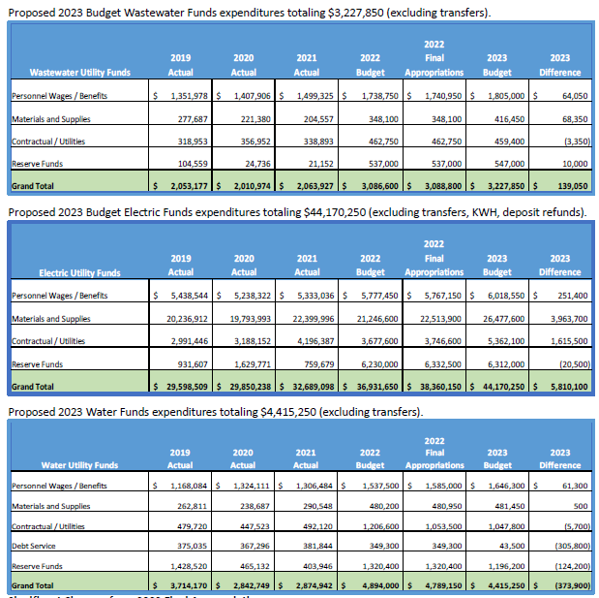
Notes:
Proposed Utility budgets.
Similar to 2022 except for increases in materials related to supply chain issues.
Source: Strimlan report for City Council workshop.

Slide 30
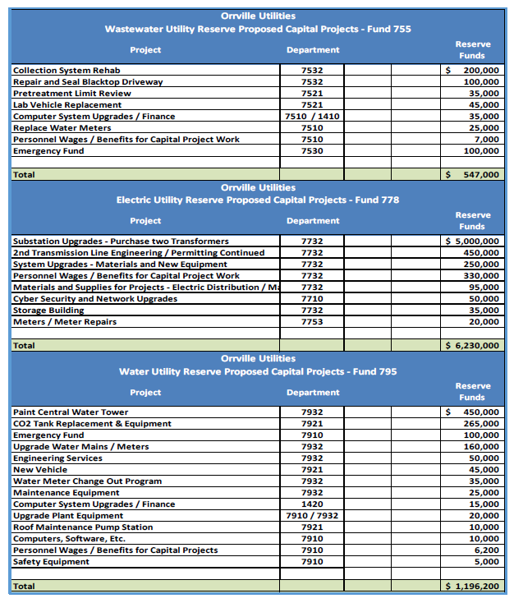
Notes:
2022 Utility Capital projects.
Taken from Ms. Strimlan’s report that will be shared at the next meeting.

Slide 31
Economic Development Mike Hedberg
In 2022, McElroy & Jarrett Logistics expanded again & JM Smucker added a new building totaling over $5M while adding 50 jobs.
Since 2002, our community has benefited from over $499M in investments and created & retained more than 2,150 jobs.
Wayne Co. was named again in top 10 micropolitan areas in the country continuing a strong, long-standing trend of improved economic strength.
We received 58 leads from JobsOhio.
Notes:
Will end the presentation on a good economic note.
ok- Mike Hedberg does an excellent job partnering with the City, Chamber of Commerce, The Wayne Economic Development Council, Team NEO & the State to promote
business & industry development in our community. Administration meets with our top industrial customers in person annually. The Mayor and Hedberg visits our commercial business.
Top Micropolitan Area in America (out of 543 communities under 50k in population).
Will also be working on filling existing sites (only one left), beginning development of 3rd industrial park, workforce & real estate development.
Wayne Co unemployment rate 3.5% in 2022.
Source: Hedberg matrix, WEDC, Chamber of Commerce and DR article.

Slide 32
Upcoming Challenges & Projects
Increased focus up climate change policies & regulations targeting the power plant
Increasing transmission costs
Development of third industrial park
Eligibility to receive grants
Potential early closure of Prairie St project
Continue wastewater collection system study & mitigation efforts
Perform rate studies for utilities
Notes:
ok- Goal to minimize any changes in electric rates in 2023 and re-evaluate W & WW rate plans.
Environment pressures related to climate change and new regulations directed at fossil power plant .
Insurance was not as huge of a challenge this year.
We have been discussing the rapidly increase in transmission costs especially in 2023-2025.
We only have one industrial site left. Funding sources to develop the next park (estimated at $5-6M) are scarce which means we’ll have to get creative especially with new payroll income tax changes being considered at the statehouse which could impact the economic benefits.
Grants- No free money, very difficult to qualify.
State of Illinois passed legislation to shut down all coal (2045) & natural gas (2030) plants unless can afford to deploy carbon capture systems. PS targets 45% reduction by 2035, 100% by 2045. Debt service goes out to 2047.
WW study to identify water infiltration that pushes plant’s treating capacity during big rain events and also a source for back-ups. A lot of homes roof drains are tied into collection system.
Supply chain issues expected thru this year and next. We’ve been fortunate, for now, with staffing.

Slide 33
Thank You
Visit us at www.orrutilities.com
Questions?
Notes:
Visit our website for more information.
Several more detailed slides follow this presentation so if you have any questions, let me know.
Thank you.

Slide 34
Extra slides/add’l reference slides for all groups

Slide 35
Electric Department Dean Kallenborn, Electric Utility Manager Jeff Vogelhuber, Distribution Superintendent
Sold 300,400Mhs in retail sales (up 1.2%), plant generated about 6% of energy
Peak demand, 61,600KW, June 22, 3PM
Retail sales, $30.3M
Wholesale sales, $7.8M
298 pole miles of distribution lines covering 125 sq. miles
Notes:
ok- Updated, not used. Need to update numbers
Service area covers the eastern 1/3+ of Wayne Co. Some customers in Stark Co.
Dean retired in Dec after 38 yrs. Jeff has been with us 28 years.
Normal peak period is in late August/early Sept but we have been close the past few winters. All time peak on June 18, 2018 at 63.1MW.

Slide 36
Notes:
Extra.
Location of hydro’s are on existing lock & dam systems (operated by the Army Corp. of Engineers) on the Ohio River.
We do not have involvement in the Belleville hydro project (other AMP members do however).
The change in river elevation provides the ‘power or head’ to turn the water turbines. The greater the elevation change, the greater the output.
Three other hydro’s are located on the Ohio River. New Martinsville (Hannibal hydro) is an AMP member.

Slide 37
Notes:
Extra.
Simple version showing cross-section of hydro plant.

Slide 38
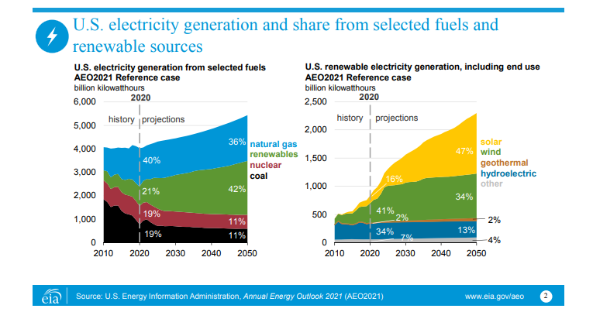
Notes:
extra-
EIA’s outlook for generation to 2050, left chart. The chart on the right is a breakout of the renewables.
At lot of focused efforts are underway to be carbon neutral (not zero carbon) before then with solar, wind & batteries.
Coal & nuclear projections are a little lower than 2019.
We need a scalable breakthrough in battery storage though to make renewables a viable & reliable energy solution.
Source: EIA

Slide 39
Notes:
ok
2022 Orrville Utilities Energy Sources

Slide 40
Orrville Wastewater Plant Steve Carathers, Superintendent
Established in 1908
Current facility constructed in 1951
Major expansions in 1969 and 1989
2.1 Million Gallons Average Flow per day
7.1 Million Gallons Maximum Flow per day
42 Miles of sewer lines, 8-42”
Treated over 800M gallons of wastewater
Operating budget, $3.2M
Notes:
Not used.
ok- This facility handles the most complex and dynamic processes of all three utilities.
We also manage seven industrial pretreatment programs- Orrville must (required by law) enforce federal, state and local industry specific discharge limits and rules for the EPA.
Steve has been with us for 2 years.

Slide 41
Notes:
Not used, combined with WW-
Water Utility.
Raw water from underground wells is pumped to the Water Plant then proceeds to lime softening, stabilization, re-carbonation, filtration, fluoridation and chlorination processes before coming to your faucet.
Fluoridation started in 1958. Once started, we can not stop per EPA regulations.

Slide 42
Orrville Water Plant Kevin Givins, Superintendent
Oldest Utility, established in 1894
New Water Treatment Plant constructed in 1997 with an EPA approved capacity of 3.7 MGD, cost $13M
In 2009, received EPA approval for an increased capacity of 6.0 MGD
Treated an average of 1.9 million gallons per day
Operating budget, $4M.
Notes:
ok- Not used.
The City was incorporated in 1864.
The Water Plant is designed to supply 100% of the water requirements to the Power Plant. We have plenty of capacity for the future and land leases in place for future wells.
Kevin has been with us 3 years.

Slide 43
Supply & Distribution System
11 wells
61 miles of water lines (sizes 4” – 16”)
2 booster pump stations
3 elevated towers (West & South 150,000 gallons, Central 275,000 gallons)
2 underground tanks (1M gallon capacity each)
1 clear well tank (800,000 gallon capacity)
3,700 customers
950 valves
450 fire hydrants
Notes:
Not used-
Central (downtown) tower (275,000 gal) built in 1938 (rehab in 2022 put on hold), West (rehab in 2020) & South towers (150,000 gal each) built in 1973.
North 1M gallon underground tank built in1974, South 1M gallon underground tank built in 1986 located at west tower site.
We can store enough for about 2 days (at 2M/day).

Slide 44
Aerial View of Plant
New 2MW Solar site located south of creek
Notes:
Not used.
Wastewater Utility site.
The 3 peaking diesel units (5.5MW) we purchased from AMP on 12/31/20 are just to the north of the grounds.
One of the two new solar sites is located south of the plant (across the creek) .

Slide 45
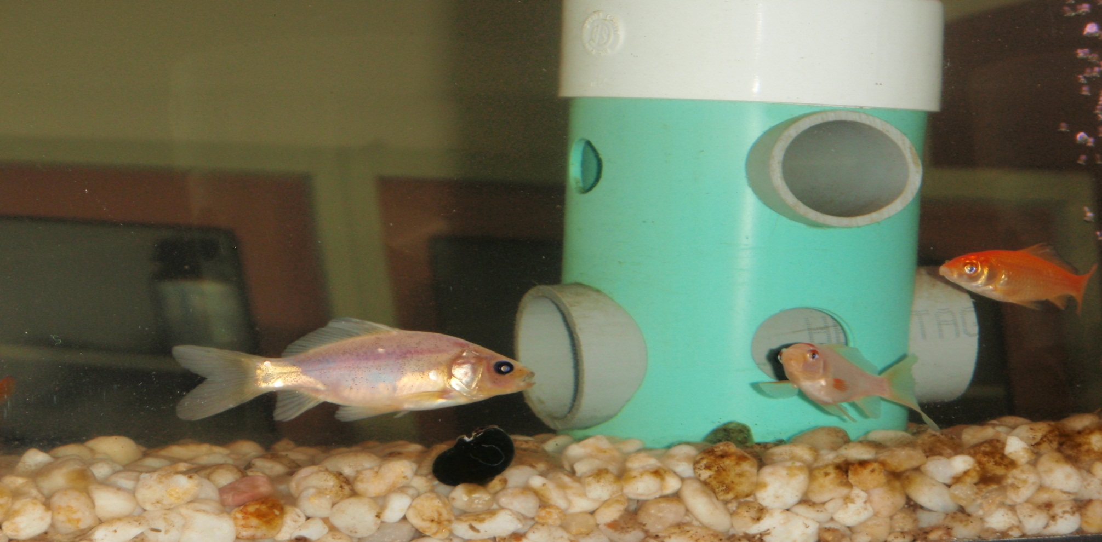
In-Line Fish Tanks, periodic bio-assays (using aquatic life), chemical and physical testing is used to confirm effluent quality to meet or exceed EPA standards before discharging to the creek.
Notes:
Combined with another slide-
A portion of the final effluent flows thru this tank and a pond in front of the office entrance.
In addition to lab tests, we also monitor daphnia (called water fleas which are small aquatic planktonic crustaceans) which are even more sensitive to water quality.

Slide 46
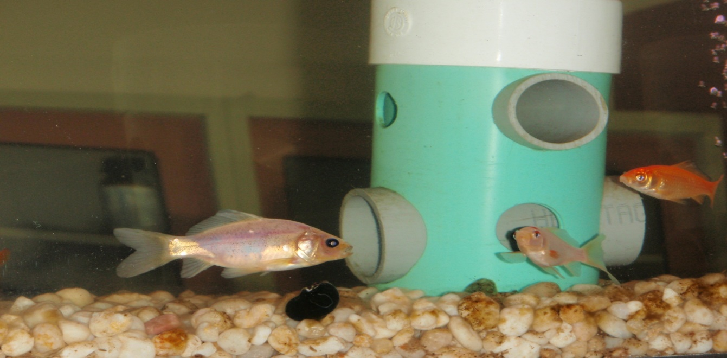
Influent Effluent
Notes:
Not used-
Typically the way ‘it’ comes into the facility for processing after pre-screening & grinding.
The water (called effluent) that is discharged into the creek is better (higher quality) than what’s typically flowing in it.
In-Line Fish Tanks, periodic bio-assays (using aquatic life), chemical and physical testing is used to confirm effluent quality to meet or exceed EPA standards before discharging to the creek.
A portion of the final effluent flows thru this tank and a pond in front of the office entrance.
In addition to lab tests, we also monitor daphnia (called water fleas which are small aquatic planktonic crustaceans) which are even more sensitive to water quality.

Slide 47
Hydro projects
Notes:
Ok- Skip slide for 2022.
Let’s start with the hydro projects.
These were the largest undertaking of hydro development in the US for decades, 4 plants, 350MW, $3.5B project when we first started in 2008.
Only 3% of the ~84,000 existing dams in the US produce electricity.
These are views of the Phase I hydro project owned by AMP members developed along the Ohio River on existing locks & dam systems.
Phase I has 79 participants and Phase II has 48 participants.
These projects took 4-5 years to construct and will be around for over 80+ years.
High costs in the beginning (due to high capital), low cost energy after debt is retired in 2045 and 2049.
Each site excavated 2.5-4M cubic yards of material at a cost of $40-70M and used over 90,000 cubic yards of concrete for the power house.
Cannelton 88MW, Orrville 2.49MW (Phase I)
Smithland 76MW, Orrville 2.15MW (Phase I)
Willow Island 44MW, Orrville 1.25MW (Phase I)
Meldahl 112MW, Orrville 3.46MW (Phase II)
Greenup 70MW, Orrville 2.25MW (Phase II)
Received 11.7MW, 60,400MWhs,15.2% of our energy (59% LF) from these projects in 2022.

Slide 48
Prairie State project
Boiler House
Generator Bld.
Pollution control equipment
Cooling towers
Notes:
Ok- Skip detailed slide for 2022. A $4B, 2 unit, 1600MW state-of-the-art coal-fired plant located in Illinois (25+ times bigger than our power plant).
Over $1B in pollution control equipment. We also own 25+ year coal supply (~$1B) underground, next to plant, a huge benefit.
The coal mine is 200’ underground, 7-9’ coal seam. Provides long term stability on fuel pricing. Plant burns in 1 year what would have taken us 32 years prior to 2017.
Orrville is one of 68 participants owning a 25% majority share of the project. This facility was started up in June 2012.
Efficiency and capacity (output) is higher than originally projected. A base load plant utilizing an abundant fuel source.
The project was awarded a grant to demo carbon capture & storage to promote long-term viability in an anti-carbon environment.
Received 5MW, 38,750MWhs or 8.7% of our energy from this project in 2022.

Slide 49
Fremont Project
Notes:
Ok- Skip detailed slide for 2022. A $675M, two unit, 700MW natural gas-fired, combined cycle plant located in Fremont, OH. Orrville is one of 87 participants.
The plant was started up in January 2012. Natural gas generates half the emissions of a coal plant.
AMP members purchased this uncompleted plant from FirstEnergy in 2011. Prior to this, the plant was in/out of bankruptcy, until we completed final construction ~10 years after it was first started by Calpine (a merchant builder/owner/operator).
Project continues to exceed expectations.
Received 23.8MW, 146800MWhs or 32.8% of our energy (70% Load Factor) from this project in 2022.

Slide 50
Blue Creek Wind project
Notes:
Ok- Skip detailed slide for 2022. (152) 2MW Gamesa G90 wind turbines located in Paulding & Van Wert, OH counties (located along SR30, near Ohio/Indiana border).
We do not own any assets in this project (purchasing energy only via Purchase Power Agreement thru July 2022).
Towers are 328’ tall, blades 110’ long, each unit weighs 85 tons and tracks wind direction & adjusts blade angle to optimize the wind’s energy.
This power supply only contract started delivering energy in June 2012 thru June 2022 and was an opportunity for us to purchase energy below actual cost due to weak market prices.
Received 2MW, 3200MWhs or 0.7% of our energy (18% Load Factor) from this project in 2022.
If we were relying solely on these, the lights would have been out ~82% of the time!

Slide 51
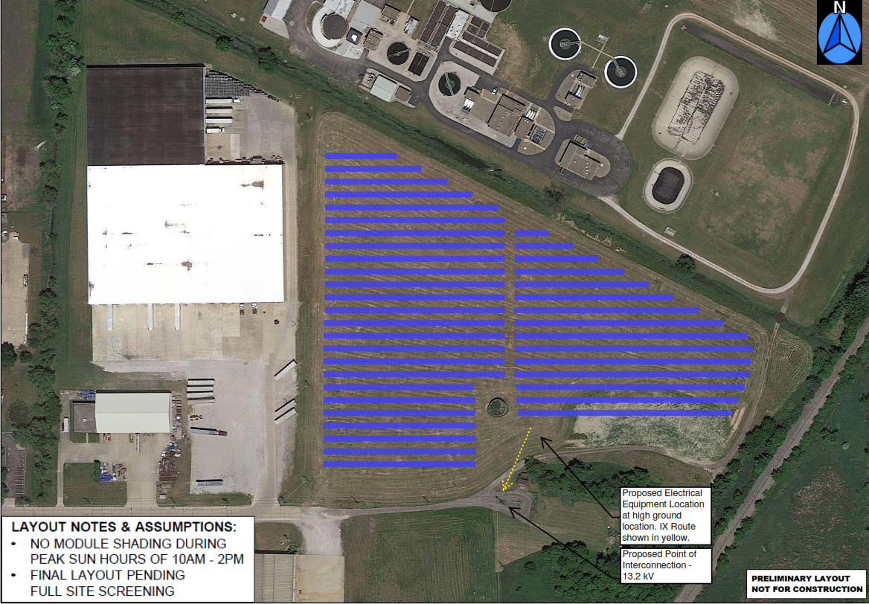
D&S Distributor’s
Warehouse
RTT Route
Railroad
Allen Dr
Notes:
Ok- Skip detailed slide for 2022. 2.25MW site located at end of Allen Dr. 10 acres (~8130 PV modules, ~3600MWh/yr, fixed mounted at 25^{o)}
In commercial operation March 3, 2018. Both sites are fenced in. The concrete tank (in middle) was removed to place additional panels.
The WWTP is to the north. The Rails to Trails route (yellow line) will follow the creek and go between warehouse building to exit on Allen Dr. in 2023-24.
Received 5750MWh’s or 1.3% (20.5% capacity factor) of our energy from both solar projects in 2022

Slide 52
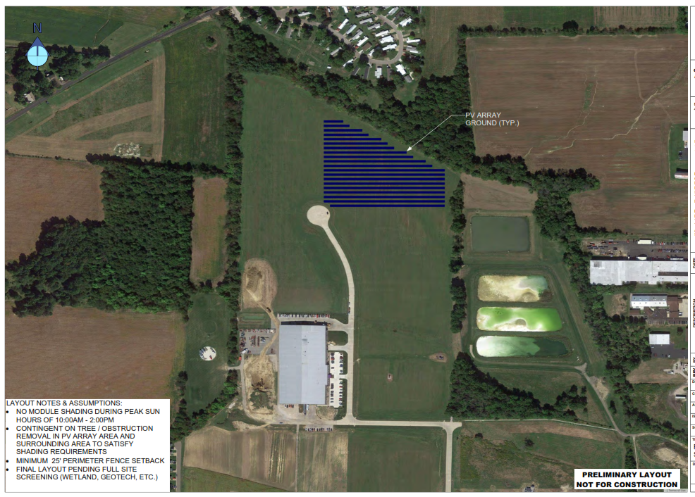
Venture Products
Animal
Supply Co.
Venture
Products
parking
Venture Products
Dairy Lane
Smith Dairy
Orrvilon
Notes:
Ok- Skip detailed slide for 2022. 0.95MW site in new industrial park. 6 acres (~5600 PV modules, original designed for 1.3MW, lower due to wetland avoidance), ~2400MWh/yr, fixed mounting at 25º )
In commercial operation on January 26, 2018. Property is in a floodplain & wetlands area and was not suitable for building.
Three Water Dept. lime lagoons on right.

Slide 53
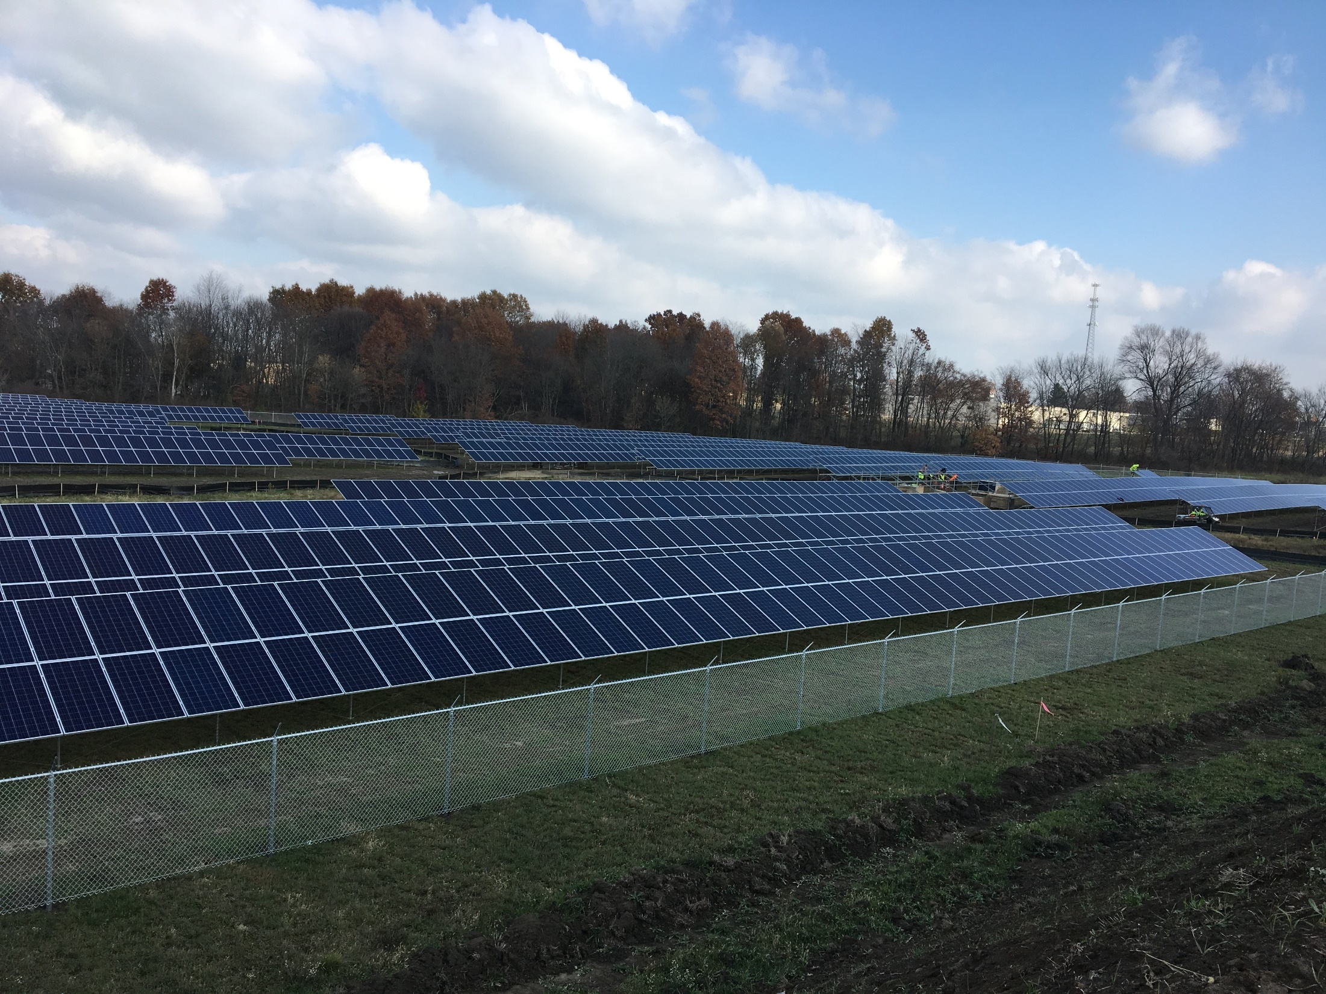
Notes:
This what the 0.95MW industrial park site looks like today.

Slide 54
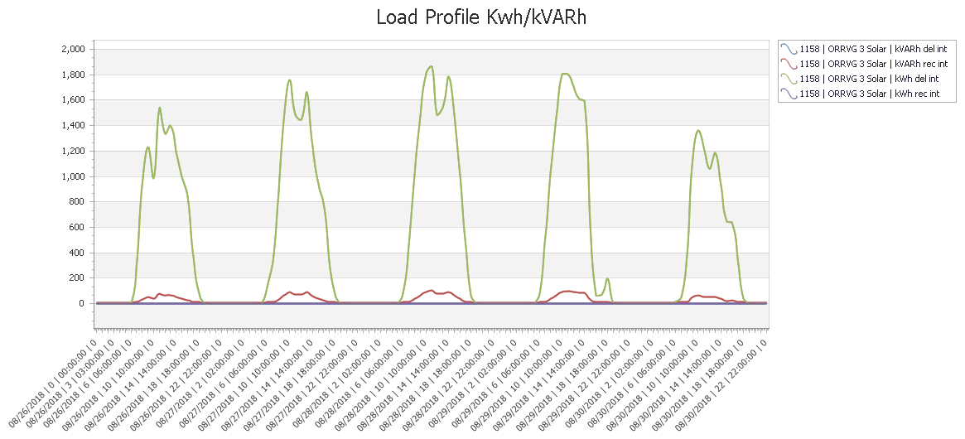
Notes:
Extra-
Typical solar output profile for Monday - Friday at the 2MW solar site. Primary power output width represents period from 10AM-4PM or about 6 hrs/day.
‘Dips’ are clouds. On Friday, a weather front was moving in and clouds were increasing.

Slide 55
Notes:
ok- We are often asked where does our energy come from when the power plant is not operating.
Red line= Retail sales, Blue Bars= Plant Capacity Factor (the percentage of time in service each month).
Capacity factor, 6.1% in 2022, based on 58MW net generating capability (example: if the capacity factor is 45%, this means that the plant was operating at 45% of it’s capability during the time period). The Power Plant used to operate at 60% capacity factor annually up to January 2017. We have the capability to meet all of our needs for a short period of time like an emergency due to a grid black out.
From AMP Invoice Summary report.

Slide 56
Notes:
Ok- 2022

Slide 57
COVID
Notes:
ok- Other factors effecting energy usage.
Source: Post COVID financial impacts report

Slide 58
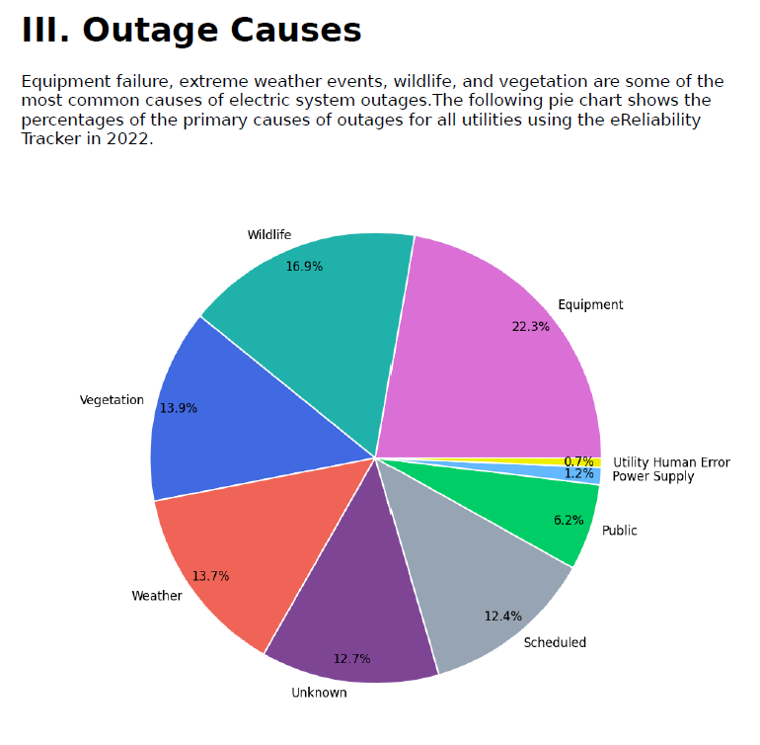
Notes:
Source: 2022 APPA Benchmark report

